Slide 1
Progress report

Slide 2
Evaluation metric
Positive : error codeword
Negative : correct codeword
True Positive (TP) : predict error , exactly error
True Negative (TN) : predict correct , exactly correct
False Negative (FN) : predict correct , exactly error
False Positive (FP) : predict error , exactly correct

Slide 3
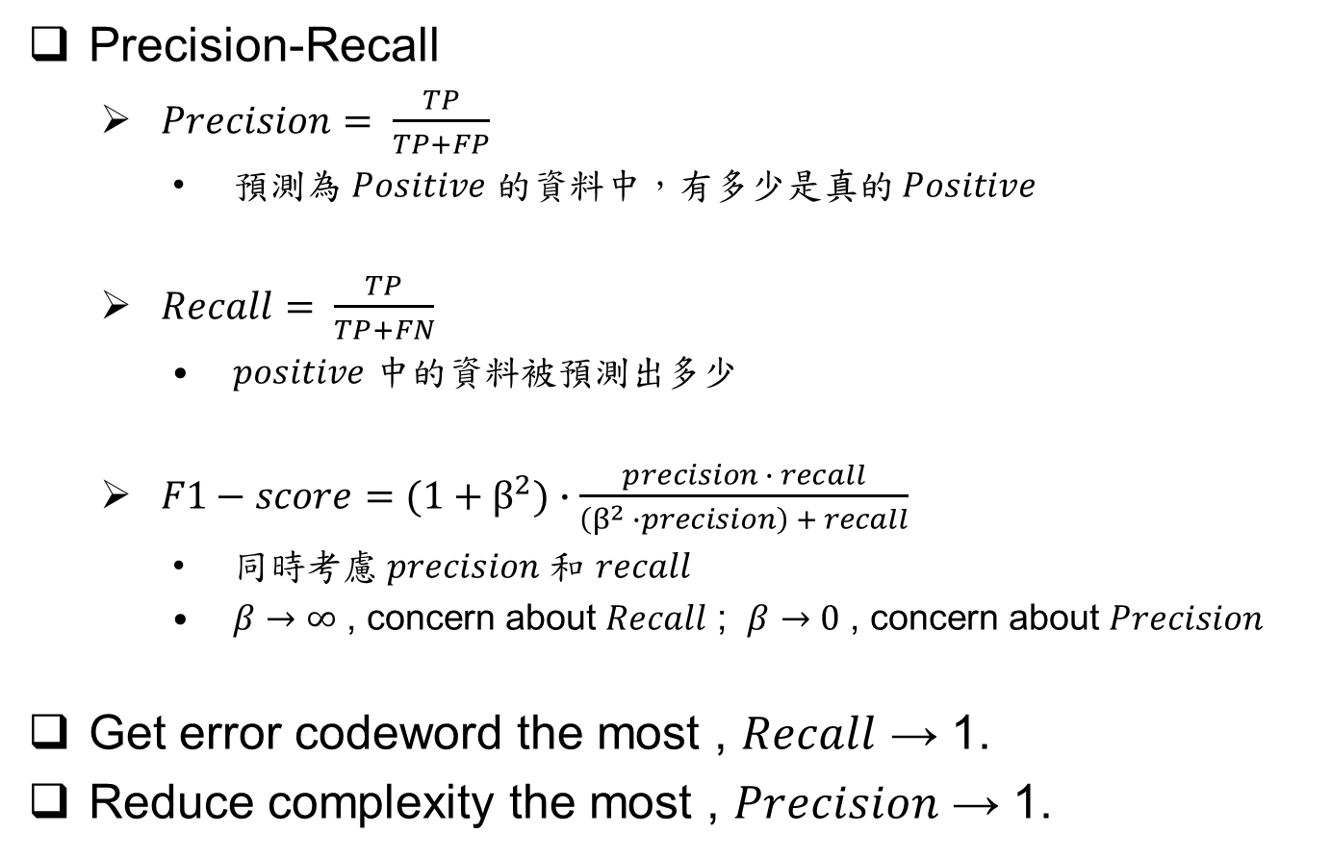
Evaluation metric
Precision-Recall
$Precision= \frac{TP}{TP+FP}$
預測為 $Positive$ 的資料中，有多少是真的 $Positive$
$Recall= \frac{TP}{TP+FN}$
$positive$ 中的資料被預測出多少
$F1−score=(1+β^{2})∙\frac{precision ∙ recall}{\left(β^{2} ∙precision\right) + recall}$
同時考慮 $precision$ 和 $recall$
$β→∞$ , concern about $Recall$ ; $β→0$ , concern about $Precision$
Get error codeword the most , $Recall$ → 1.
Reduce complexity the most , $Precision$ → 1.

Slide 4

Evaluation metric
TPR-FPR
$TPR= \frac{TP}{TP+FN}$
The same as $precision$
預測為 $Positive$ 的資料中，有多少是真的 $Positive$
$FPR= \frac{FP}{FP+TN}$
$Negative$ 被誤認成 $positive$ 的比例

Slide 5
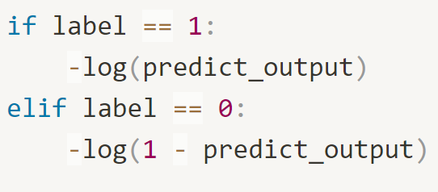
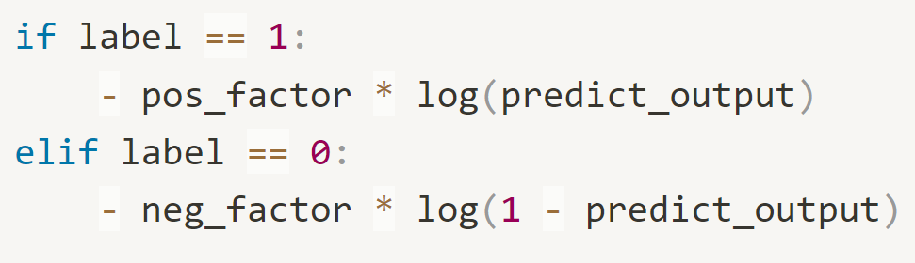
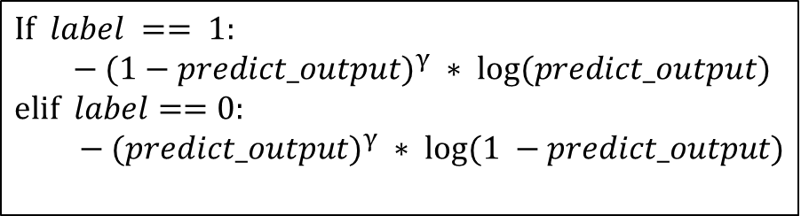
Loss function
Binary cross entropy
Weighted BCE
Focal
$$If label == 1:$$
$$− (1−predict_output)^{γ} ∗ log⁡(predict_output)$$
$$elif label==0:$$
$− (predict_output)^{γ} ∗ log⁡(1 −predict_output)$

